Slide 1
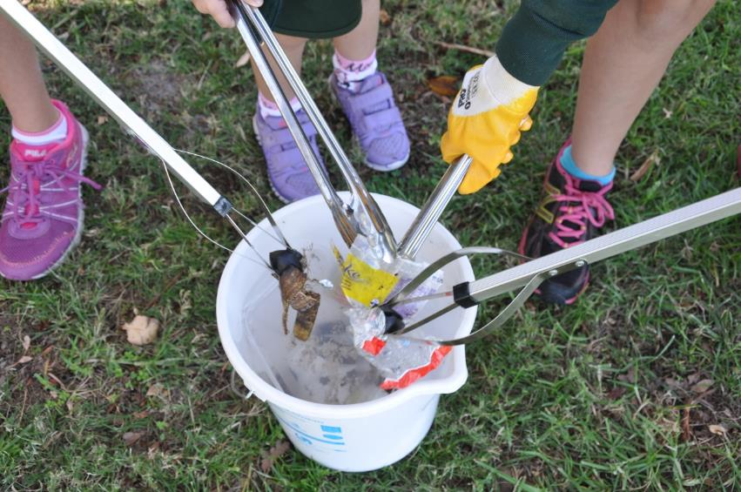

Ready. Set. Clean Up!

Slide 2
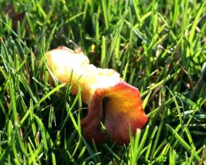
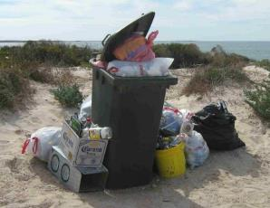
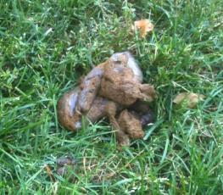

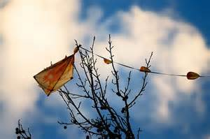
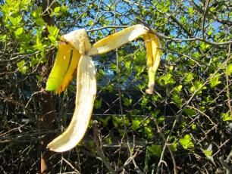
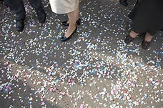
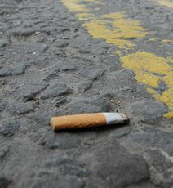
What is litter?
Notes:
Before you show images,
what sorts of things do you see littered around the school?
what sorts of things do you see littered in your community?
Show images
Which of these do you think are litter? Answer: All of them.

Slide 3
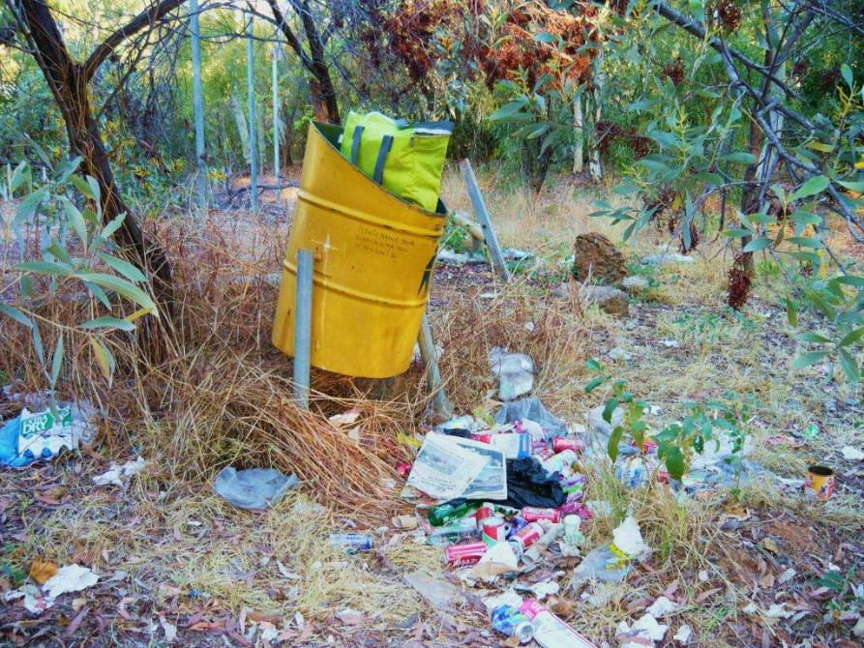
LITTERING
Leaving rubbish beside a bin?
Notes:
Do you think this is littering or not?
It is!
How does it make you feel?
How does it look?
What problems could this cause?

Slide 4
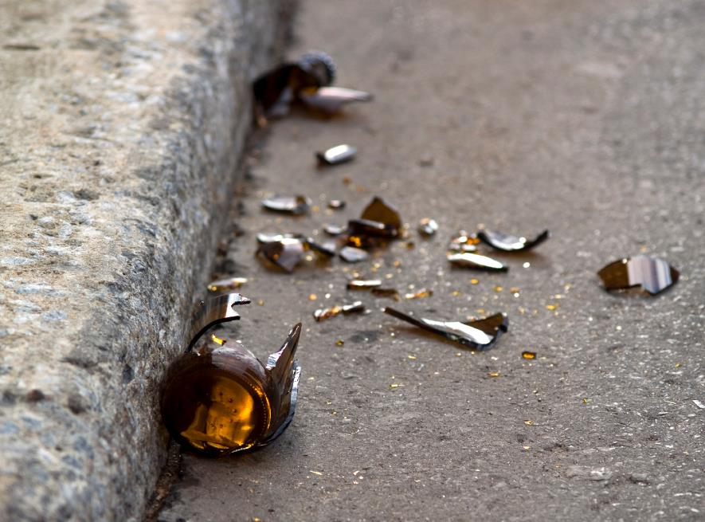
LITTERING
Throwing a bottle in the gutter?
Notes:
Do you think this is littering or not?
It is!
How does it make you feel?
How does it look?
What problems could this cause?

Slide 5
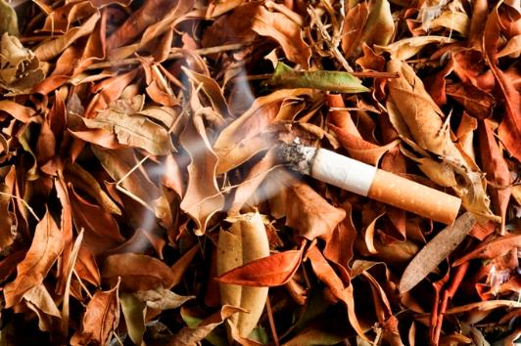
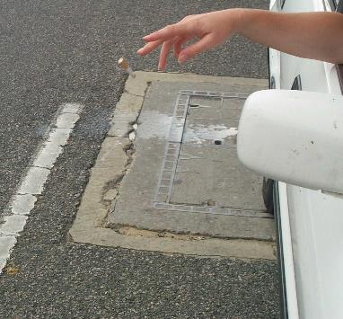
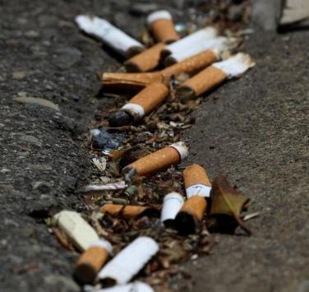
LITTERING
Throwing a cigarette butt on the ground?
Notes:
Do you think this is littering or not?
It is!
How does it make you feel?
How does it look?
What problems could this cause?

Slide 6
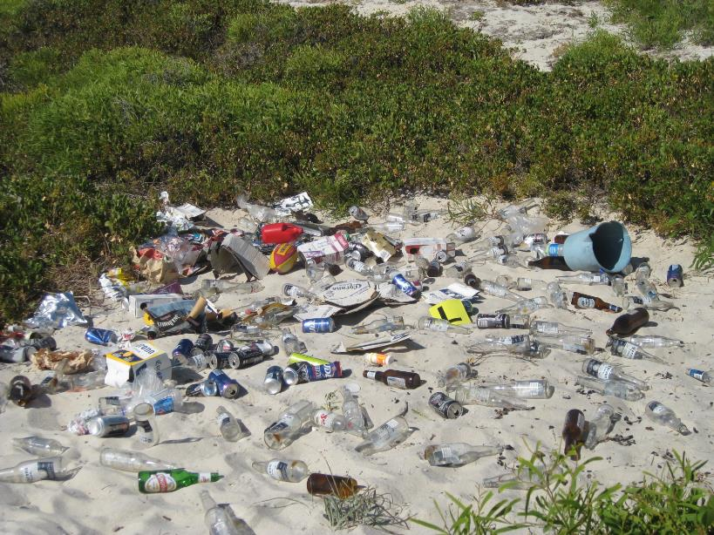
LITTERING
Leaving rubbish at the beach?
Notes:
Do you think this is littering or not?
It is!
How does it make you feel?
How does it look?
What problems could this cause?

Slide 7
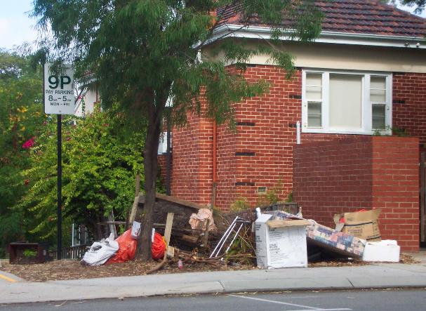
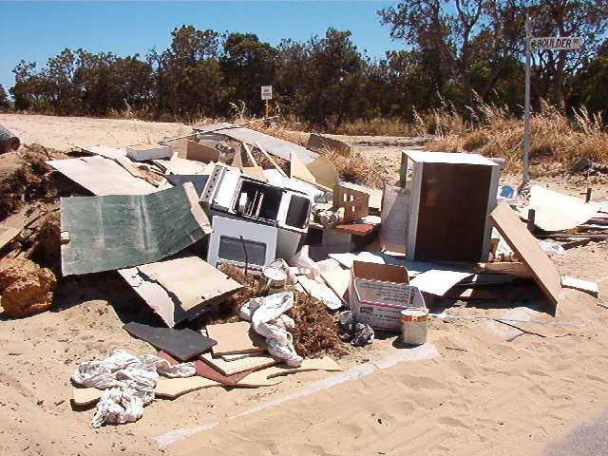
LITTERING
Dumping unwanted rubbish?
Notes:
Do you think this is littering or not?
It is!
How does it make you feel?
How does it look?
What problems could this cause?

Slide 8
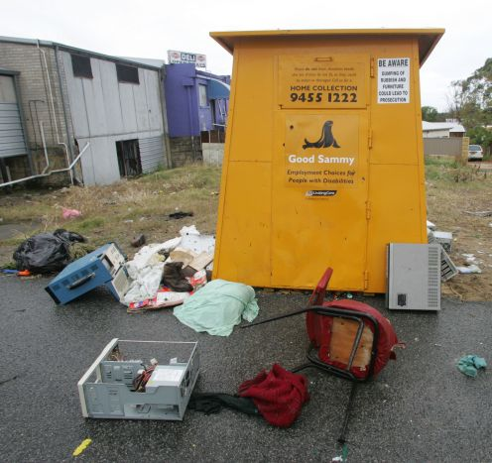
LITTERING
Leaving unwanted goods beside a charity bin?
Notes:
Do you think this is littering or not?
It is!
How does it make you feel?
How does it look?
What problems could this cause?

Slide 9
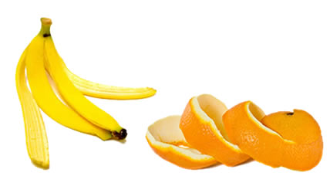
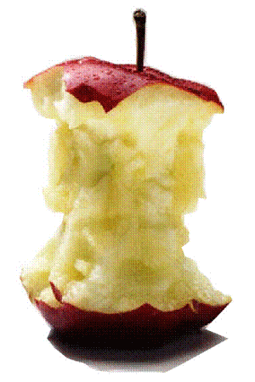
LITTERING
Throwing fruit cores or skins?
Notes:
Do you think this is littering or not?
It is!
How does it make you feel?
How does it look?
What problems could this cause?

Slide 10
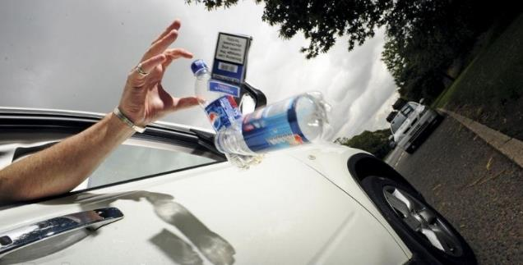
Litter is
anything not disposed of correctly.

Slide 11
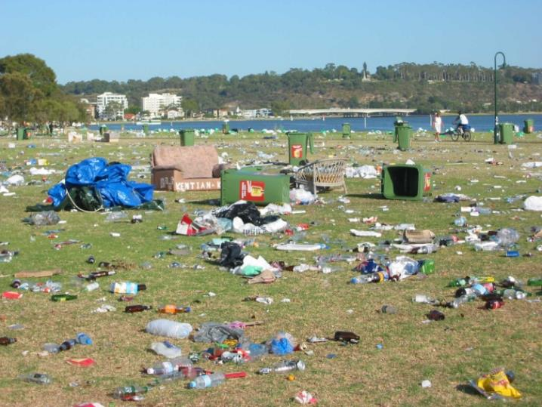
Why worry about litter?
Notes:
Photo from Skyworks. Notice the litter and the number of bins. Any ideas on why the bins aren’t used?

Slide 12
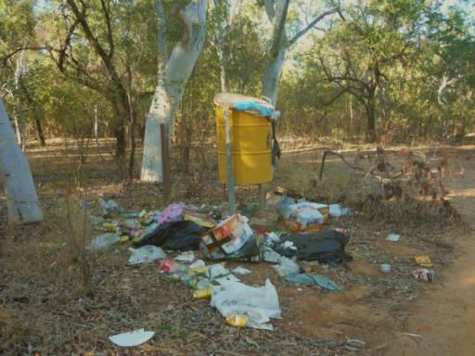
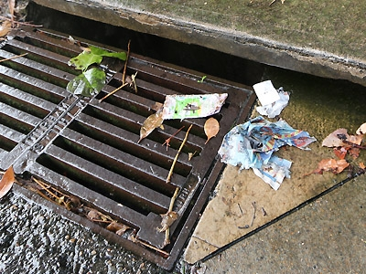
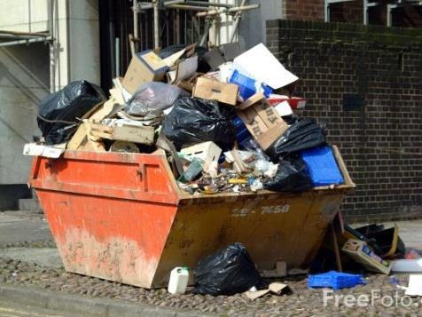
Litter hurts the environment
Notes:
Litter in stormwater drains leads straight to waterways such as a river or the ocean.

Slide 13
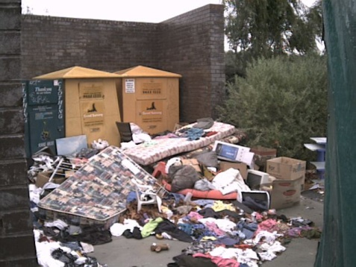
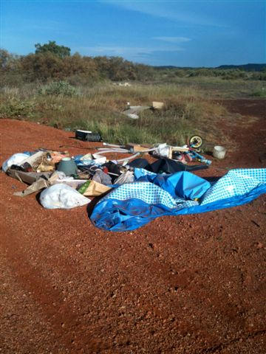
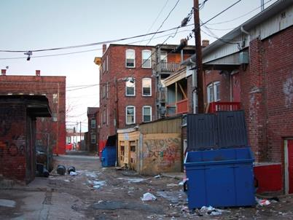
Litter is ugly

Slide 14

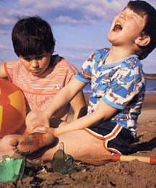
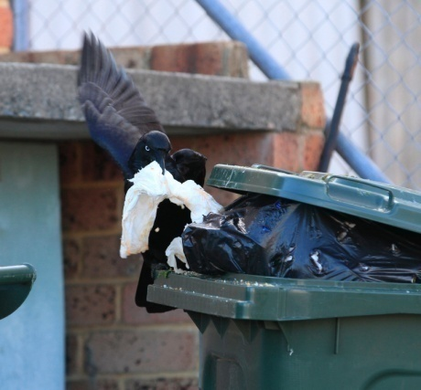
Litter can be dangerous
Notes:
People can be hurt by broken glass.
Lit cigarettes can cause fires.
Bins can attracts vermin or be a breeding ground for bacteria

Slide 15
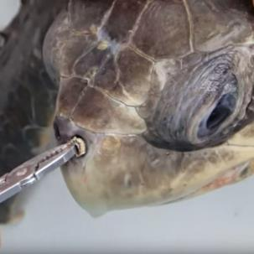
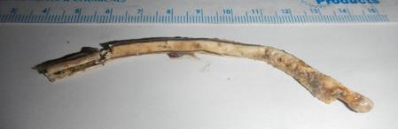
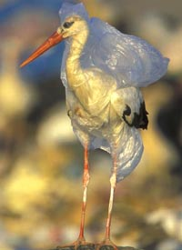
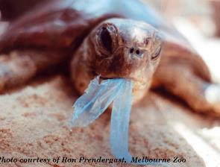
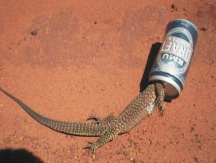
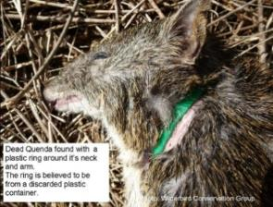
Litter can harm or kill wildlife
Litter can harm or kill wildlife
Notes:
Plastic litter can choke or suffocate animals
Turtle and bird with plastic bags
Carelessly discarded containers can trap small animals
Lizards and cans
Quenda and milk container ring
Turtle and straw

Slide 16

What can I do?
Notes:
Sometimes feel helpless.
Make sure your own rubbish goes in the bin.
The message is easy.
Use KAB resources to promote Bin It message.
http://www.kabc.wa.gov.au/campaigns/bin-it

Slide 17
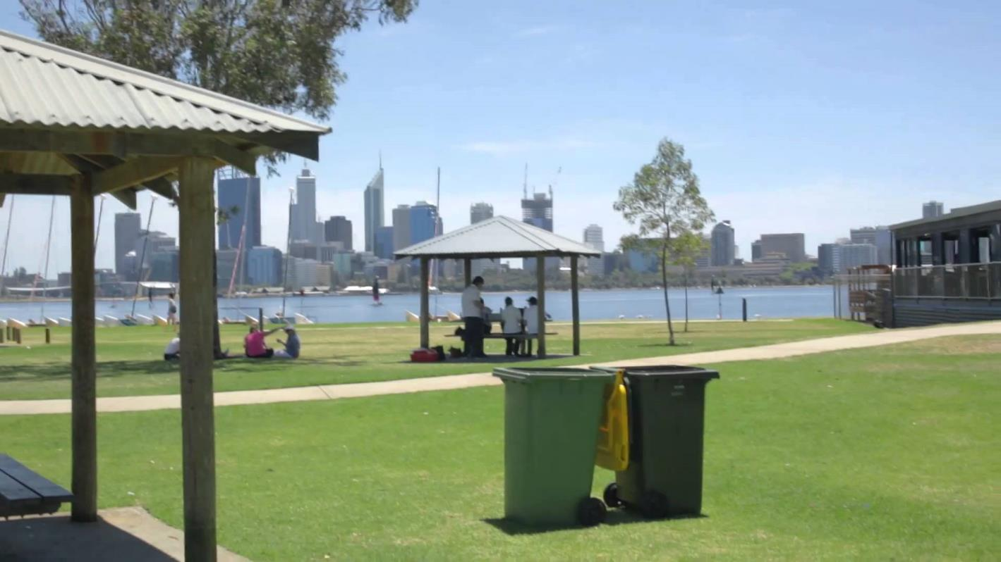

Notes:
This is the cinema ad from the Too Easy campaign.
For more information visit
http://www.kabc.wa.gov.au/campaigns/bin-it

Slide 18
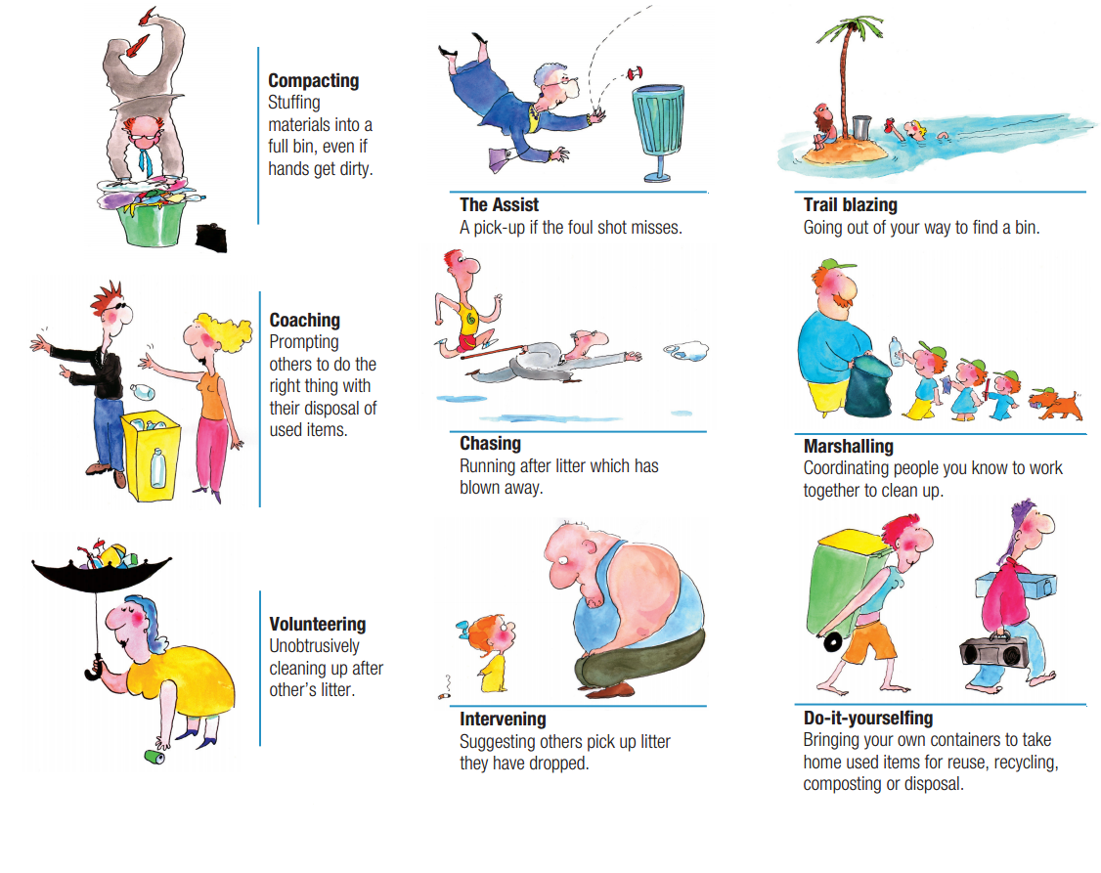
Notes:
These are positive behaviours encouraged by the Victorian Litter Alliance.
http://www.litter.vic.gov.au/-/media/sv-vlaa/littering-behaviour/littering-behaviours-poster-a2.pdf?la=en

Slide 19
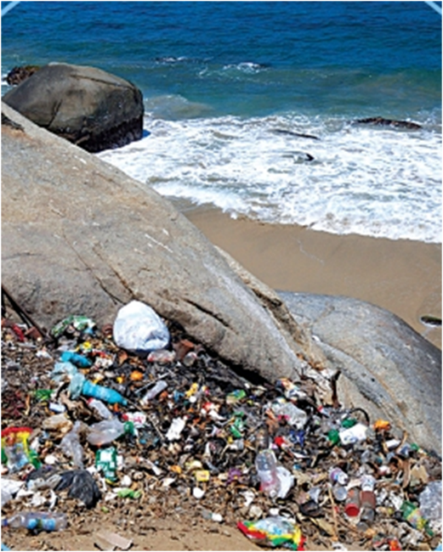
How does this make you feel?
Notes:
Describe the photo. What can you see? How does it make you feel?

Slide 20
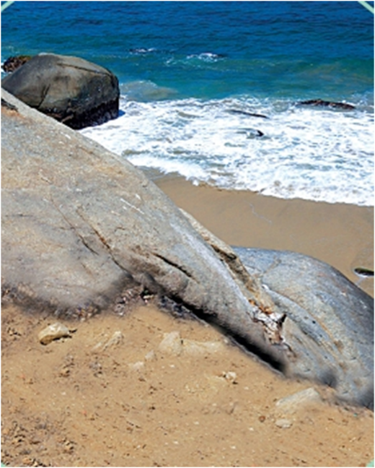
Ah, that’s better.

Slide 21
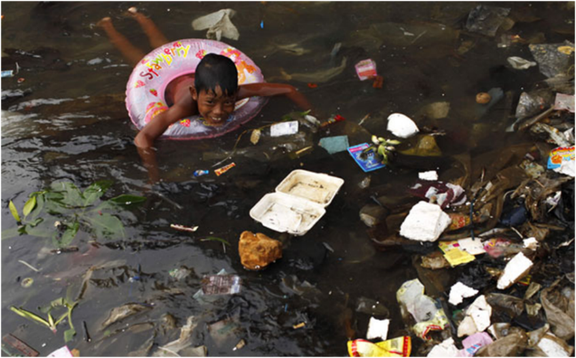
Would you swim here?
Notes:
Describe the photo. What can you see? How does it make you feel?

Slide 22
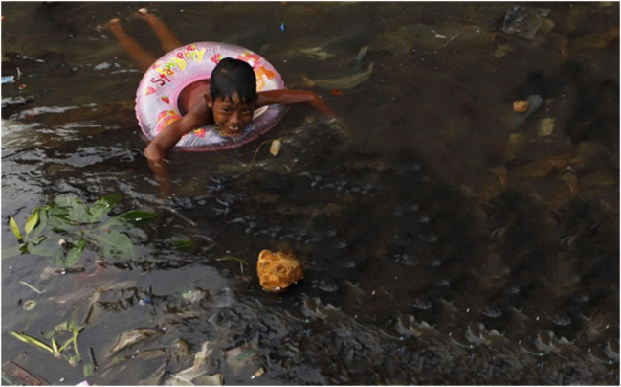
Ah, that’s better.
Notes:
Describe the photo. What can you see? How does it make you feel?
Show other photos.
Describe the photo. What can you see? How does it make you feel?
Photo on the right is the original photo.
Which do you prefer?

Slide 23
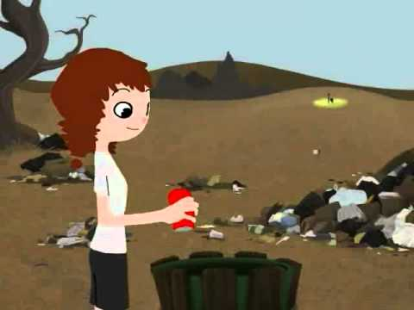
Notes:
Trash My Ad competition winner. No text or words. All visual. Great for all ages and non-English speakers.

Slide 24
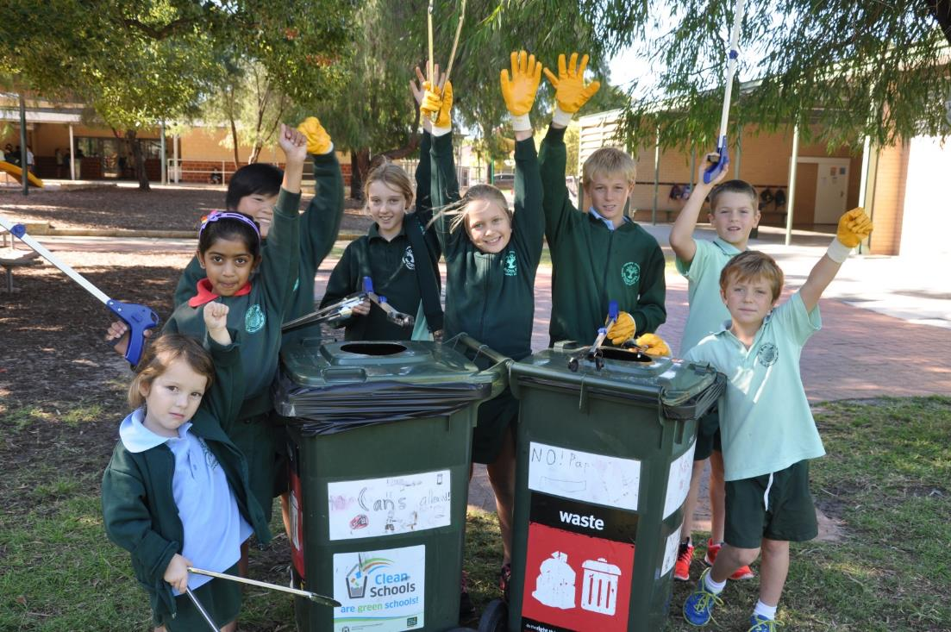
Let’s get cleaning!

